Slide 1
Visual simulator for high quality planning domain models
Software Engineering 2: Project Teamwork Mälardalen University
Group #2
Client : Ericsson
Contact : Swarup Kumar Mohalik

Slide 2
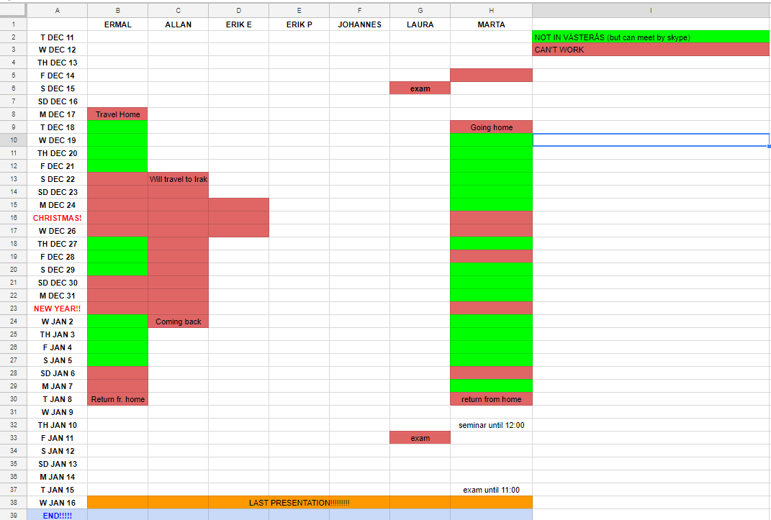
What we did last week
Created work calendar for Christmas break

Slide 3
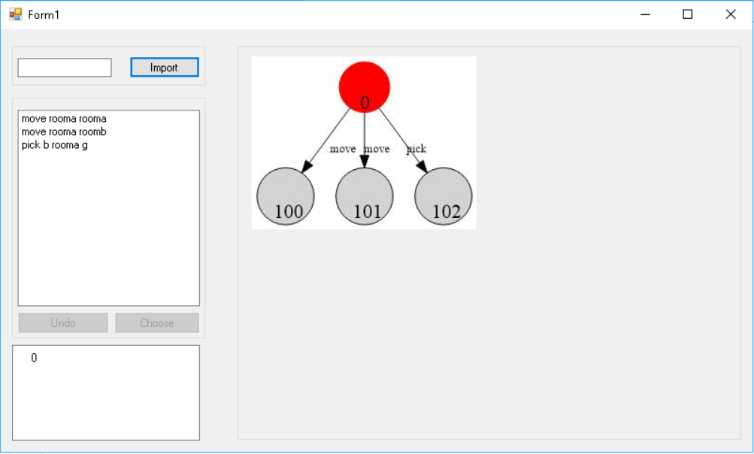
What we did last week
Continued with implementation of the tool
Used Graphviz to create to visualize the states

Slide 4
What we did last week
Met with the client via Skype
He was happy with the progress we’ve made so far with the tool

Slide 5
Worked hours
Members | W.4 | W.5 | W.6 | Total
Marta | 19 | 22 | 19 | 60
Erik E | 22 | 22 | 23 | 67
Erik P | 19 | 17 | 19 | 55
Allan | 18 | 20 | 19 | 57
Laura | 20 | 17 | 20 | 57
Ermal | 18 | 15 | 18 | 51
Johannes | 20 | 19 | 21 | 60

Slide 6
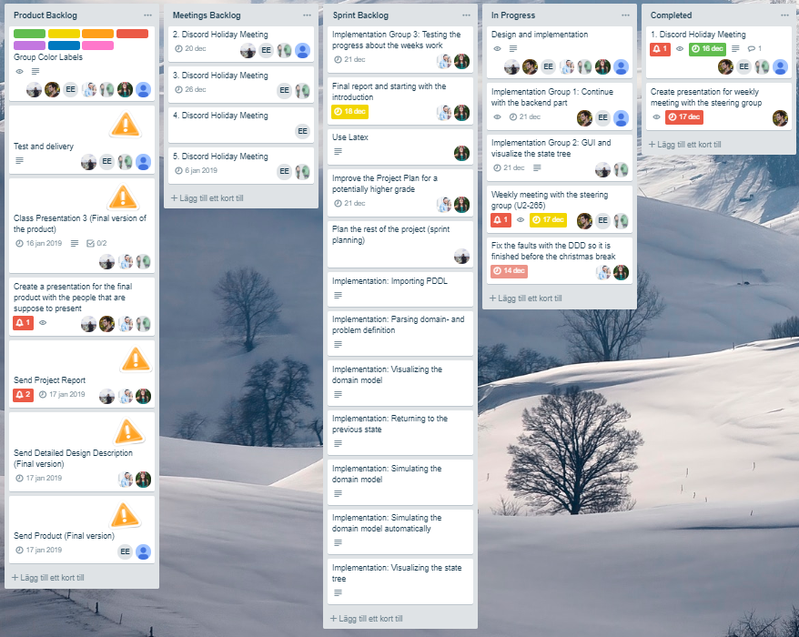
What are we doing this week

Slide 7
What we will be doing over the holiday
Functionality to import files
Create a tree structure
Automatically generate the state tree for a specified level
Functionality for resetting (Low priority)
Research the VAL-tool
Extra functionalities

